Slide 1

Machine Learning for Engineers: Clustering
Mina Farmanbar
Associate Professor, University of Stavanger
for engineers

Slide 2
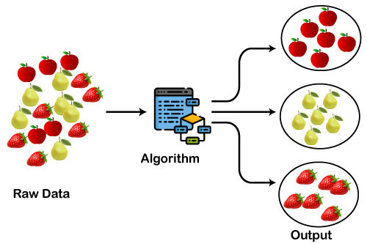
Clustering
Clustering is the task of dividing the unlabeled data or data points into different clusters such that similar data points fall in the same cluster than those which differ from the others.
https://static.javatpoint.com/tutorial/machine-learning/images/clustering-in-machine-learning.png

Slide 3
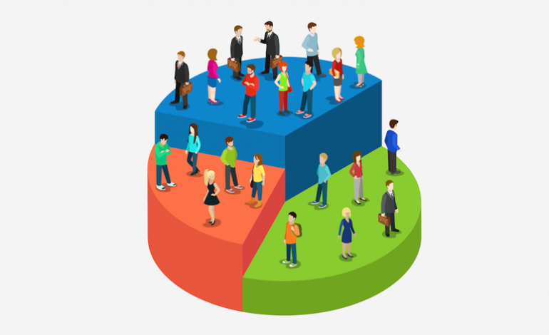
Clustering
Clustering can group data in an unsupervised manner based on customer similarities.
It partitions customers into mutually exclusive groups, such as three clusters, where customers within each cluster are demographically similar.
We can then create profiles for each group by analyzing their common characteristics.
Young, Educated and middle income
Rich and middle age
Young and low income
https://miro.medium.com/v2/resize:fit:770/1*I84-PCI-kCuSkd7vDt_luQ.png

Slide 4
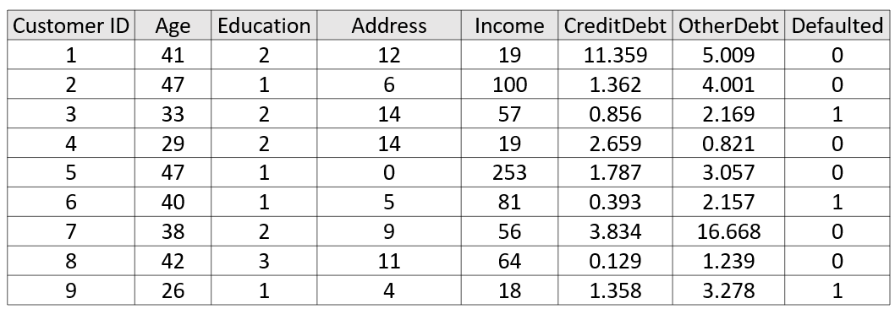
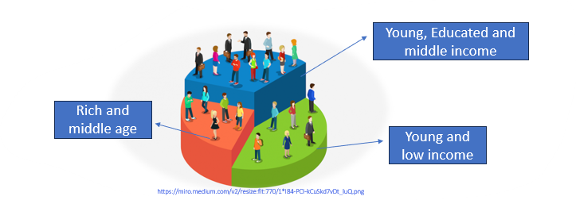
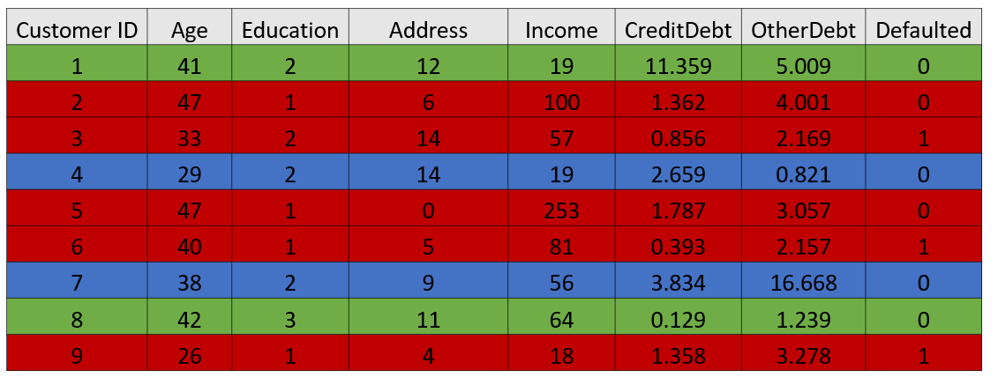
Clustering

Slide 5
Clustering
Now the question is,
" What is different between clustering and classification?"

Slide 6
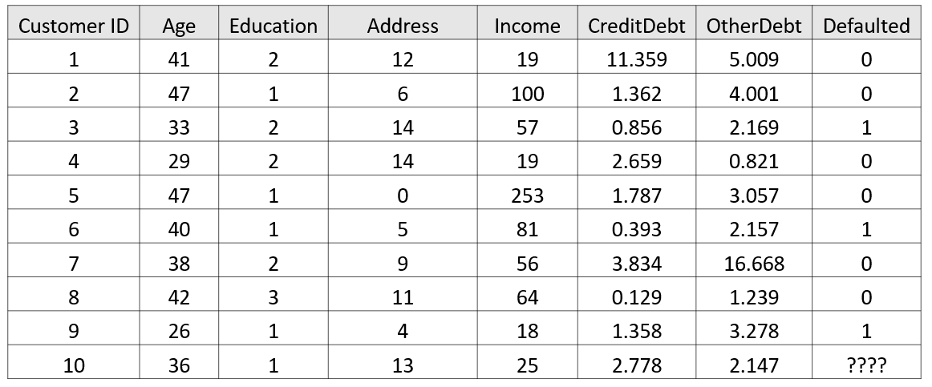

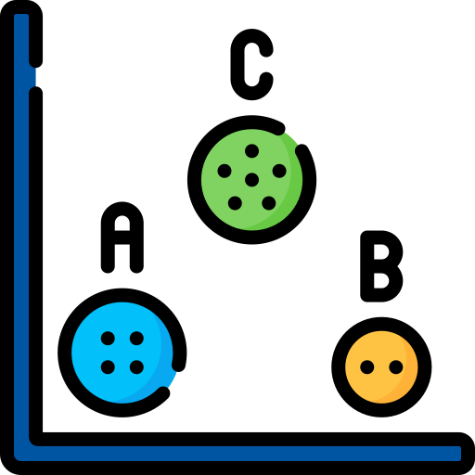
Clustering
Modeling
Categorical Variables
Classifier
Prediction
Modeling
Clustering
Segmentation

Slide 7
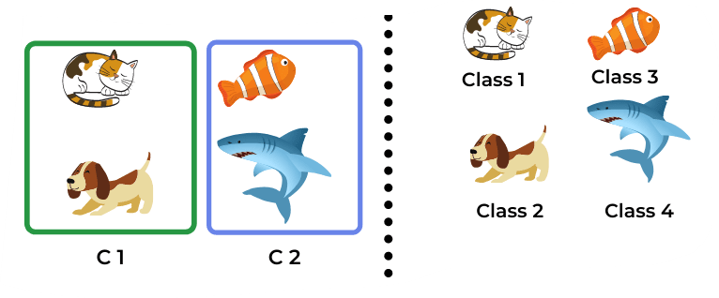
Clustering
Clustering
Classification
https://dataaspirant.com/wp-content/uploads/2020/12/5-Clustering-Vs-Classification-Example.png

Slide 8
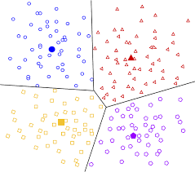
Types of Clustering Algorithms
Centroid-based Clustering (known as Partitioning methods)
It partitions a dataset into clusters where each cluster is represented by a centroid
K-Means
K-Median
https://encrypted-tbn0.gstatic.com/images?q=tbn:ANd9GcTM82V-AIvSnadRvThXZsOmYBXZLOG5604pdA&s

Slide 9
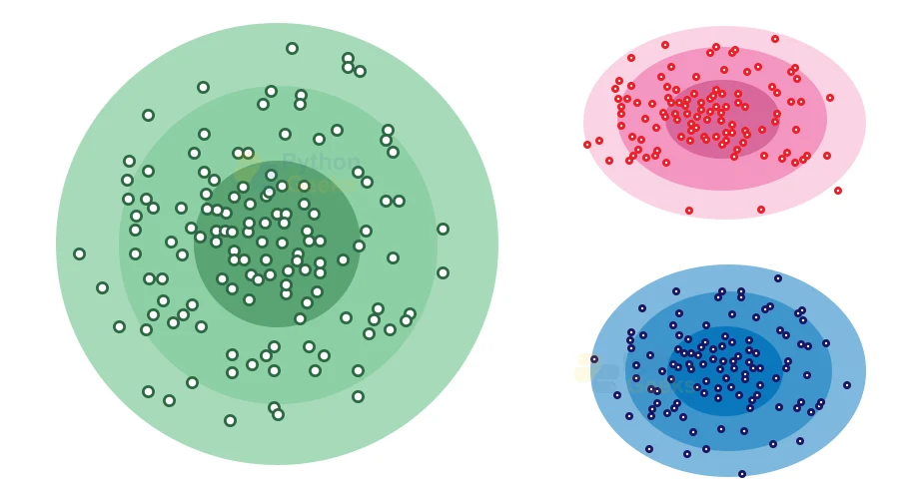
Types of Clustering Algorithms
Density-based Clustering (Model-based methods)
It identifies clusters based on the density of data points
It produces arbitrary shaped clusters
DBSCAN (Density-Based Spatial Clustering of Applications with Noise)
https://pythongeeks.org/wp-content/uploads/2022/12/distribution-model-based-clustering.webp

Slide 10
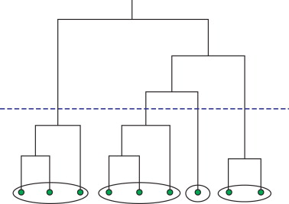
Types of Clustering Algorithms
Connectivity-based Clustering (Hierarchical clustering)
Does not require a predefined number of clusters
It builds a hierarchy of clusters from either a bottom-up (agglomerative) or top-down (divisive) approach based on the similarity or dissimilarity between data points.
https://ars.els-cdn.com/content/image/3-s2.0-B9780128008911000068-f06-08-9780128008911.jpg

Slide 11
Clustering Applications
Retail/Marketing
Identifying purchasing patterns of customers
Banking
Fraud detection in credit card use
Insurance
Fraud detection in claims analysis

Slide 12
Clustering Applications
Publication
Auto categorization news based on their content
Libraries
It is used in clustering different books on the basis of topics and information.
Medicine
Characterizing patient behavior

Slide 13
Summary
The main difference between clustering and classification is that classification is a supervised learning algorithm and clustering is an unsupervised learning algorithm.
We apply clustering to those datasets that without a target variable.

Slide 14
Thank you!
Mina Farmanbar
mina.farmanbar@uis.no

